Slide 1
Information Extraction from Micro-blogs Posted during
Disasters
Mrinal Aich, Shamik Kundu, Vaibhav Singh

Slide 2
Problem Statement description:
A large set of tweets posted during recent Nepal disaster event along with a set of topics (in TREC format) is given. Each ‘topic’ will identify a broad information need during a disaster.
Aim is to develop IR methodologies for extracting relevant tweets according to a given set of topics describing a generic information need during the disaster situation.

Slide 3
Drawback of other known approaches:
No labels & small data content: The data-set given doesn't contain any label and the text present in each tweet is very less to use any kind of supervised learning method for classification.
tf-idf scoring: The weighted score of words calculated cannot help in classifying in our case.
NLP based algorithms can’t be used since the sentence frames are not grammatically structured.

Slide 4
Choice of Algorithm for the problem:(1/2)
Our Approach:
Create a bag of words for each class which consists of uni-grams and bi-grams.
Compare each tweet with these bag of words to calculate a similarity based score.
Set a particular threshold and if for a tweet the value of score of all the classes is below this threshold then mark the tweet as not useful.
Use manually labeled data for 1000 tweets for supervised learning (SVM training) and then get the label for another set of 1000 tweets occurring in a different time interval using combined score of SVM and similarity feature.

Slide 5
Choice of Algorithm for the problem:(2/2)
5. For training purpose of SVM, unigrams will be used as feature.
6. Increasingly add more words to bag of words and remove some if they are very less frequent.
7. Repeat the process for a couple of times attempting to capture tweets at different time intervals to annotate another set of 1000 tweets to train SVM.
8. Classify rest of the tweets based on uni-grams, bi-grams and SVM score.

Slide 6
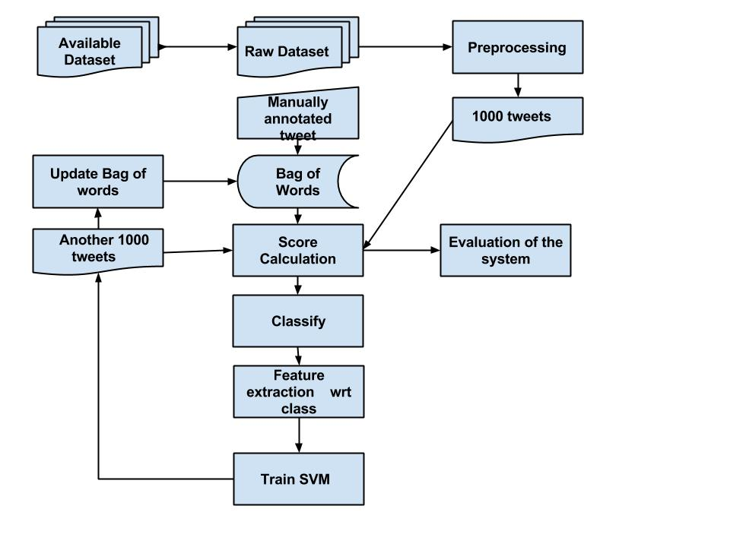
Framework of proposed model:

Slide 7
Work done so far:
Raw tweets are extracted from the available json file.
Bag of words is generated manually for 7 given classes. Till now, we worked on classification of 3 classes out of 7.
Preprocessing: Normalized acronyms, removal of special symbols, case-folding.
1000 tweets are manually annotated for evaluating the system for precision, recall and f-measure.
Classification is done for 3 classes based on similarity based scores with the bag of words.

Slide 8
Formulas:
Evaluation of the results are done on the basis of following metrics: Calculated Score(each class) = weight of unigram * unigrams matched + weight of bigram * bi-grams matched.
Proposed formula for future work:

Slide 9
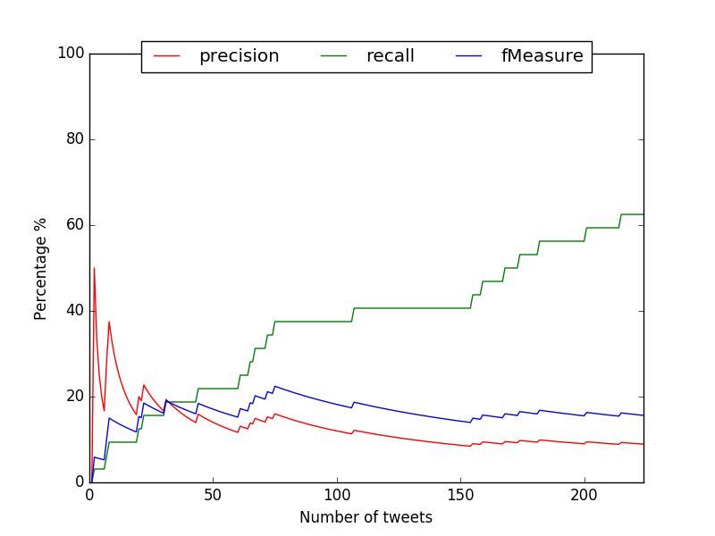
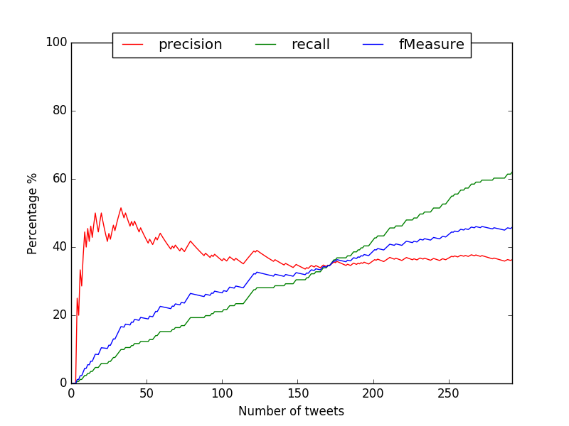
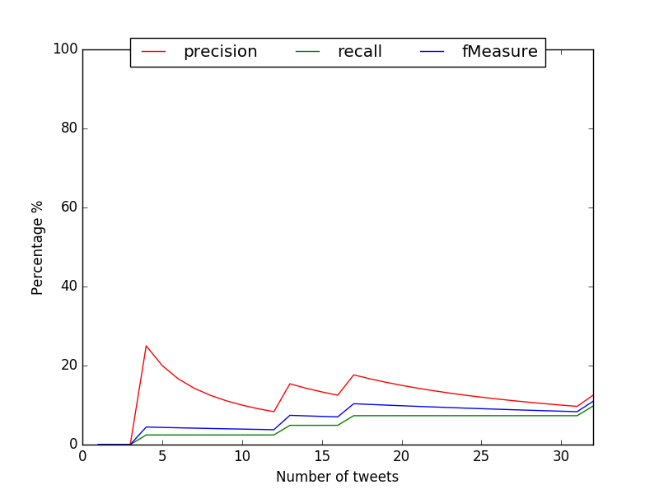
Results so far:(1/2)
Precision, Recall and F-measure Graphs:
FI
Fig 3. NGO/Government works
Fig2. Resources Required/Available Fig4. Medical resources required/ available

Slide 10
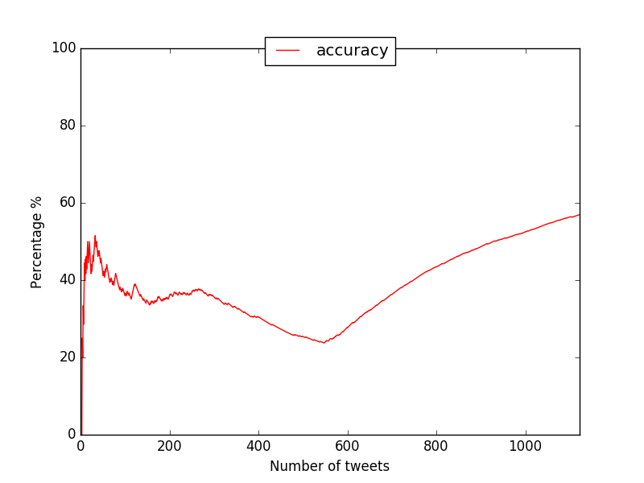
Results so far:(2/2)
System accuracy:
System Accuracy changes according to the accuracy of the tweets classified in various classes.

Slide 11
Work Planned next…
Integrate SVM learning for our classification.
Expand model to classify all 7 classes.
Removing less frequent words from Bag of words updated by SVM. (remove unwanted words)
Preprocessing: 1. Substring matching using regexp, e.g ModiGovt 2. Handling abbreviations.

Slide 12
THANK YOU

